Slide 1
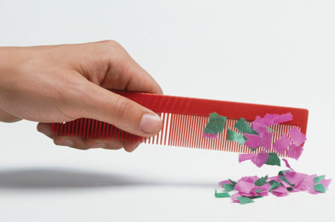
Electric Charge and Electric Field

Slide 2
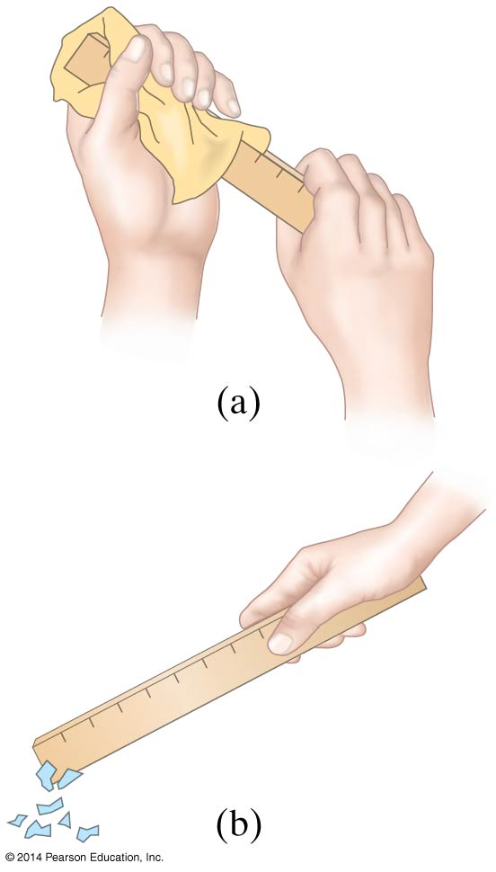
Static Electricity; Electric Charge
Objects can be charged by rubbing

Slide 3
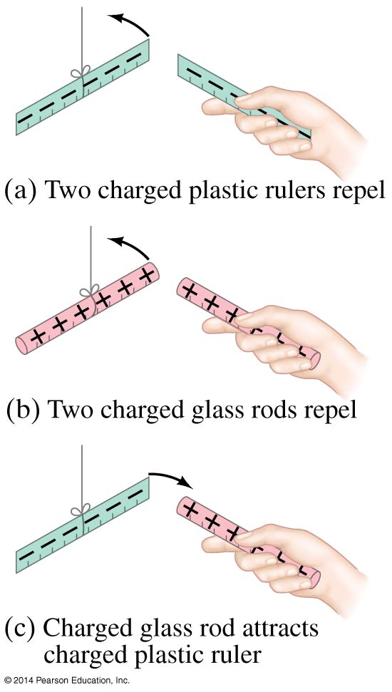
Static Electricity; Electric Charge
Charge comes in two types, positive and negative; like charges repel and opposite charges attract

Slide 4
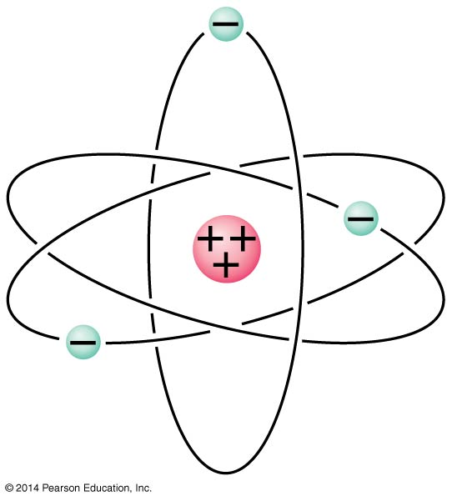
Electric Charge in the Atom
Atom:
Nucleus (small, massive,
positive charge)
Electron cloud (large, very
low density, negative
charge)

Slide 5
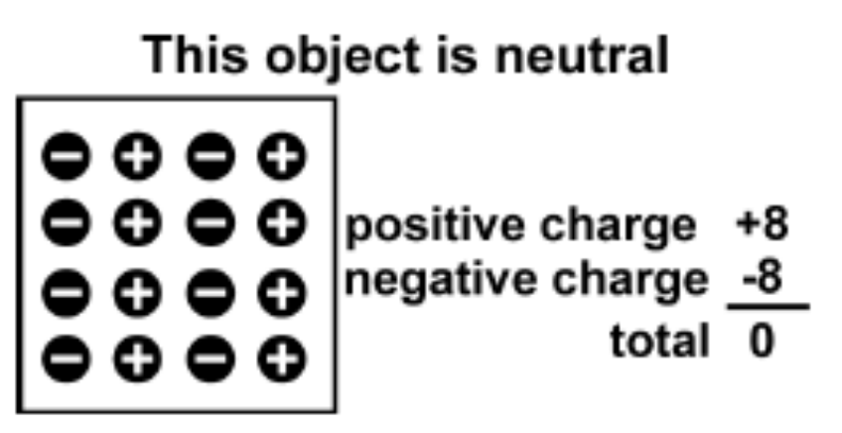
Electric Charge in the Atom
All ordinary matter contains both positive and negative charge.
You do not usually notice the charge because most matter contains the exact same number of positive and negative charges.
An object is electrically neutral when it has equal amounts of both types of charge.

Slide 6
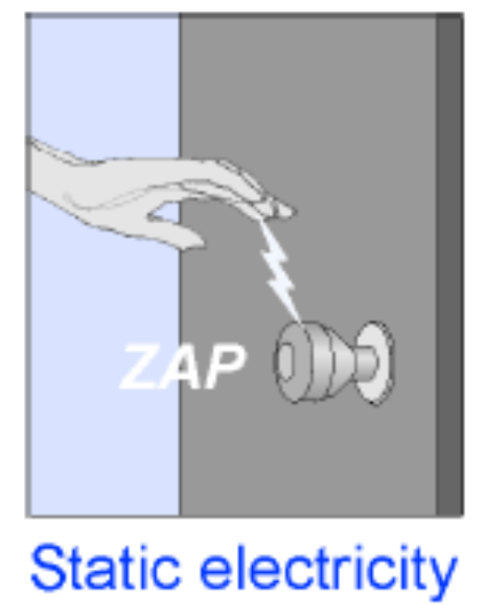
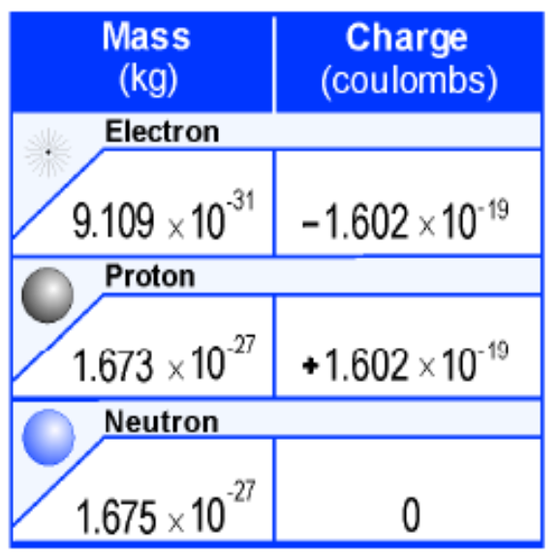
Electric Charge
Objects can lose or gain electric charges.
The net charge is also sometimes called excess charge because a charged object has an excess of either positive or negative charges.
A tiny imbalance in either positive or negative charge on an object is the cause of static electricity.
Electric charge is a property of tiny particles in atoms.
The unit of electric charge is the coulomb (C).
A quantity of charge should always be identified with a positive or a negative sign.

Slide 7
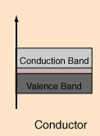
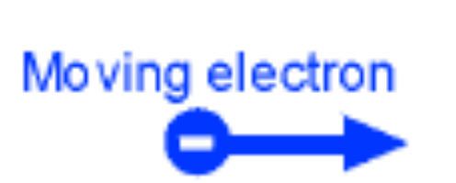

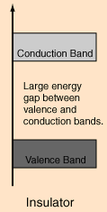

Conductors and Insulators
All materials contain electrons.
The electrons are what carry the current in a conductor.
The electrons in insulators are not free to move—they are tightly bound inside atoms.

Slide 8
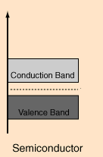
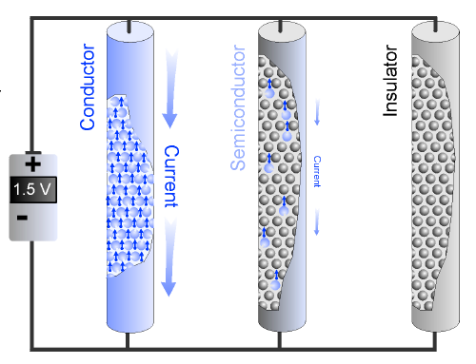
A semiconductor has a few free electrons and atoms with bound electrons that act as insulators.

Slide 9
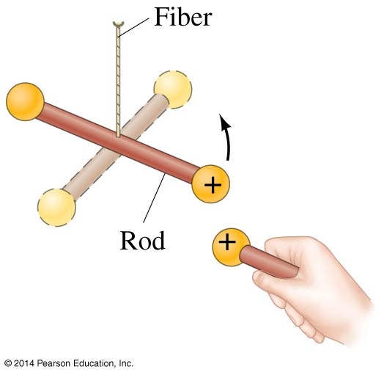
Coulomb’s Law
Experiment shows that the electric force between two charges is proportional to the product of the charges
and inversely proportional
to the square of the distance between
them.

Slide 10
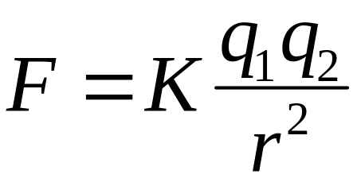
Coulomb’s Law
Coulomb’s law relates the force between two single charges separated by a distance.
Force (F) depends on charge (q)
F ∝ q₁ ; F ∝ q₂
Force depends on the inverse square of the distance (r) between the charges
F ∝ 1/r²
F ∝ (q₁ q₂)/r²
r
F
-
-
q₂
F
q₁

Slide 11
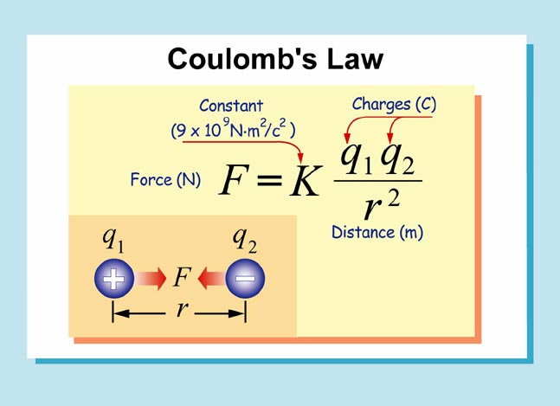

Slide 12
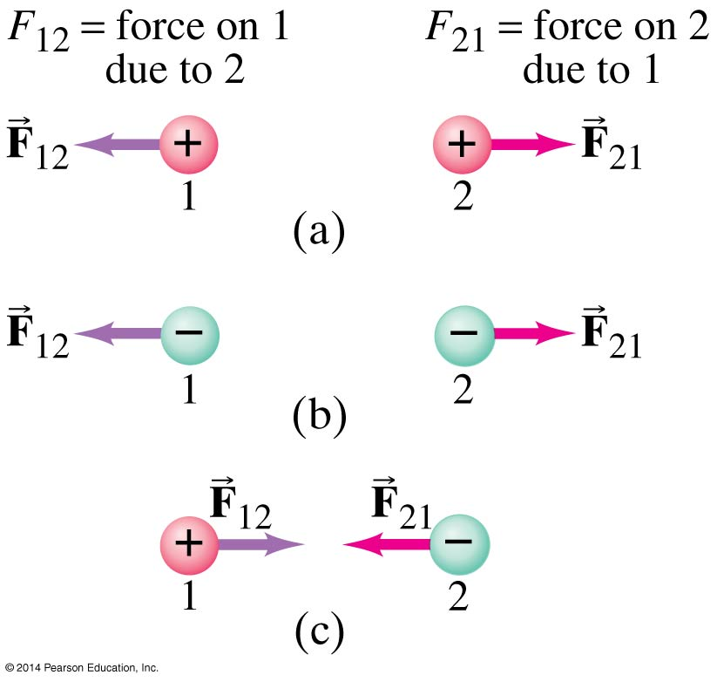
Coulomb’s Law
The force is along the line connecting the charges, and is attractive if the charges are opposite, and repulsive if they are the same.

Slide 13
Coulomb’s Law
Unit of charge: coulomb, C
The proportionality constant in Coulomb’s law is then:
k = 8.988 × 10⁹ N∙m²/C²
Charges produced by rubbing are typically around a microcoulomb:
1 µC = 10⁻⁶ C

Slide 14
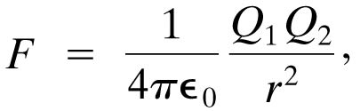
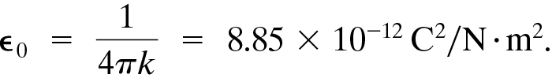
Coulomb’s Law
The proportionality constant k can also be written in terms of ε₀, the permittivity of free space:
(16-2)

Slide 15
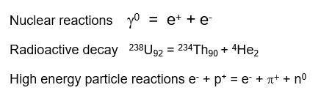
Conservation of Charge
Electric charge is conserved—the arithmetic sum of the total charge cannot change in any interaction.

Slide 16

Quantization of charge

Slide 17
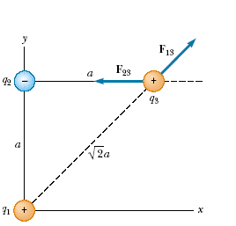




Calculate the Force
Consider three point charges located at the corners of a right triangle as shown in Figure. Find the resultant force exerted on q3 .

